Slide 1

Book Recommender System
Presenter: Janice

Slide 2
Business Problem

Slide 3
Contents
EDA
Modelling
Insights
Limitations
Next steps

Slide 4
EDA
Modelling
Insight
Limitations
Next Steps
User
User ID (Anonymized)
Location
Book
ISBN
Title
Rating
User ID
Rating (0-10)
Age
Year of Publication
Publisher
Author
Image
ISBN

Slide 5
EDA
Modelling
Insight
Limitations
Next Steps
User
User ID (Anonymized)
Location
Book
ISBN
Title
Rating
User ID
Rating (0-10)
Age
Year of Publication
Publisher
Author
Image
ISBN

Slide 6
EDA
Modelling
Insight
Limitations
Next Steps

Slide 7
EDA
Modelling
Insight
Limitations
Next Steps

Slide 8
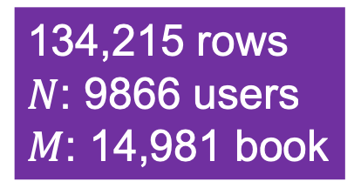
EDA
Modelling
Insight
Limitations
Next Steps
Subset
Book > 10 reviews
User > 10 reviews
134,215 rows
$N$: 9866 users
$M$: 14,981 book

Slide 9
EDA
Modelling
Insight
Limitations
Next Steps
Book > 10 reviews
User > 10 reviews
134,215 rows

Slide 10
EDA
Modelling
Insight
Limitations
Next Steps
Popularity-based
User-based
Matrix Factorization
Item-based

Slide 11
EDA
Modelling
Insight
Limitations
Next Steps
Popularity-based • User-based • Item-based • Matrix Factorization
Top 5 Most Reviewed

Slide 12
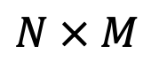
EDA
Modelling
Insight
Limitations
Next Steps
Popularity-based • User-based • Item-based • Matrix Factorization
 | Book 1 | Book 2 | Book 3 | Book 4 | Book 5
User 1 | 4 |  | 8
User 2 |  | 6 | 9 |  | 5
User 3 | 5 |  |  | 6
User 4 |  | 7 | 8 |  | 5
$$N × M$$
Raw Data

Slide 13
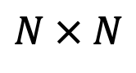
EDA
Modelling
Insight
Limitations
Next Steps
Popularity-based • User-based • Item-based • Matrix Factorization
 | Book 1 | Book 2 | Book 3 | Book 4 | Book 5
User 1 | 4 |  | 8
User 2 |  | 6 | 9 |  | 5
User 3 | 5 |  |  | 6
User 4 |  | 7 | 8 |  | 5
$$N × M$$
Raw Data
 | User 1 | User 2 | User 3 | User 4
User 1 | 1 | 0.56 | 0.50 | 0.44
User 2 | 0.56 | 1 | 0.00 | 0.89
User 3 | 0.50 | 0.00 | 1 | 0.00
User 4 | 0.44 | 0.89 | 0.00 | 1
$$N × N$$
Similarity Matrix

Slide 14
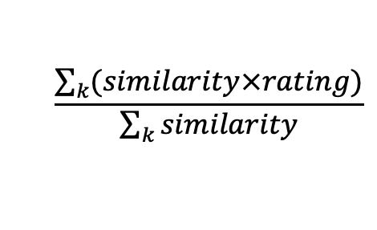
EDA
Modelling
Insight
Limitations
Next Steps
Popularity-based • User-based • Item-based • Matrix Factorization
 | Book 1 | Book 2 | Book 3 | Book 4 | Book 5
User 1 | 4 | 6 | 8 | 6 | 5
User 2 |  | 6 | 9 |  | 5
User 3 | 5 |  |  | 6
User 4 |  | 7 | 8 |  | 5
$$N × M$$
Raw Data
KNN
$$\frac{\sum_{k}{(similarity×rating)}}{\sum_{k}{similarity}}$$
 | User 1 | User 2 | User 3 | User 4
User 1 | 1 | 0.56 | 0.50 | 0.44
User 2 | 0.56 | 1 | 0.00 | 0.89
User 3 | 0.50 | 0.00 | 1 | 0.00
User 4 | 0.44 | 0.89 | 0.00 | 1
$$N × N$$
Similarity Matrix

Slide 15
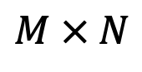
EDA
Modelling
Insight
Limitations
Next Steps
Popularity-based • User-based • Item-based • Matrix Factorization
 | User 1 | User 2 | User 3 | User 4 | User 5
Book 1 | 4 |  | 8
Book 2 |  | 6 | 9 |  | 5
Book 3 | 5 |  |  | 6
Book 4 |  | 7 | 8 |  | 5
$$M × N$$
Raw Data

Slide 16
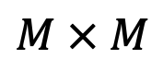
EDA
Modelling
Insight
Limitations
Next Steps
Popularity-based • User-based • Item-based • Matrix Factorization
 | User 1 | User 2 | User 3 | User 4 | User 5
Book 1 | 4 |  | 8
Book 2 |  | 6 | 9 |  | 5
Book 3 | 5 |  |  | 6
Book 4 |  | 7 | 8 |  | 5
$$M × N$$
Raw Data
 | Book 1 | Book 2 | Book 3 | Book 4
Book 1 | 1 | 0.56 | 0.50 | 0.44
Book 2 | 0.56 | 1 | 0.00 | 0.89
Book 3 | 0.50 | 0.00 | 1 | 0.00
Book 4 | 0.44 | 0.89 | 0.00 | 1
$$M × M$$
Similarity Matrix

Slide 17
EDA
Modelling
Insight
Limitations
Next Steps
Popularity-based • User-based • Item-based • Matrix Factorization
 | User 1 | User 2 | User 3 | User 4 | User 5
Book 1 | 4 |  | 8
Book 2 | 4 | 6 | 9 |  | 5
Book 3 | 5 |  |  | 6
Book 4 | 4 | 7 | 8 |  | 5
$$M × N$$
Raw Data
KNN
$$\frac{\sum_{k}{(similarity×rating)}}{\sum_{k}{similarity}}$$
 | Book 1 | Book 2 | Book 3 | Book 4
Book 1 | 1 | 0.56 | 0.50 | 0.44
Book 2 | 0.56 | 1 | 0.00 | 0.89
Book 3 | 0.50 | 0.00 | 1 | 0.00
Book 4 | 0.44 | 0.89 | 0.00 | 1
$$M × M$$
Similarity Matrix

Slide 18
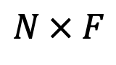
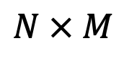
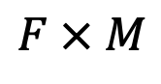
EDA
Modelling
Insight
Limitations
Next Steps
Popularity-based • User-based • Item-based • Matrix Factorization
$$F × M$$
 | Book 1 | Book 2 | Book 3 | Book 4 | Book 5
F1 | 5 | 6 | 7 | 6 | 8
F2 | 4 | 7 | 8 | 6 | 8
 | F1 | F2
User 1 | 1 | 0
User 2 | 0 | 1
User 3 | 1 | 0
User 4 | 0.5 | 0.5
 | Book 1 | Book 2 | Book 3 | Book 4 | Book 5
User 1 | 5 | 6 | 7 | 6 | 8
User 2 | 4 | 7 | 8 | 6 | 8
User 3 | 5 | 6 | 7 | 6 | 8
User 4 | 5 | 7 | 8 | 6 | 8
$$N × F$$
$$N × M$$

Slide 19
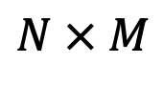
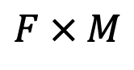


EDA
Modelling
Insight
Limitations
Next Steps
Popularity-based • User-based • Item-based • Matrix Factorization
SVD
SVD++
Book
Features
$$F × M$$
$$F × M$$
Users
$$N × F$$
$$N × M$$
Features

Slide 20
EDA
Modelling
Insight
Limitations
Next Steps
Evaluation Metrics: RMSE
Model | RMSE
User-based KNN | 1.761
Item-based KNN | 1.630
SVD | 0.737
SVD++ | 0.731

Slide 21
EDA
Modelling
Insight
Limitations
Next Steps
Test User: 2033

Slide 22
EDA
Modelling
Insight
Limitations
Next Steps
User-based
Item-based
SVD/SVD++

Slide 23

EDA
Modelling
Insight
Limitations
Next Steps
Lowest RMSE
$$≠$$
Best Recommender

Slide 24
EDA
Modelling
Insight
Limitations
Next Steps
Explicit Rating Only

Slide 25
EDA
Modelling
Insight
Limitations
Next Steps
Other Methods
Hybrid
Deep Learning
Implement
API
Demo Website

